Slide 1
“Succeeding in Physiology”
Dr. Linda Costanzo
Author of BRS Physiology
“How to Thrive” Webinar Series

Slide 2
WELCOME AND INTRODUCTION
Notes:
Dr. Costanzo and her grandson, Max.

Slide 3
Why is Physiology Different?
The stakes feel higher.
Physiology is the basis for medicine.
Physiology cannot be memorized (and you’ve become good memorizers).
Graphs, equations, and calculations (gotta love ‘em!).

Slide 4
Learning Physiology – The Philosophy
Learn “for life” (physiology undergirds all of pathophysiology and medicine)
Concepts and principles >> isolated facts
Hierarchy of concepts, connections, recurring themes

Slide 5
Learning Physiology – Best Practices
The cycle:
Pre-read = warm the circuits
Books or lecture notes
2. Attend class
Having pre-read, class time is learning time
3. Review
4. Practice questions
Repeat!

Slide 6
Books or Not?
Books tell same story, in different voice.
See hierarchy
Provide cohesion
Fill gaps
Spot help for difficult topics

Slide 7
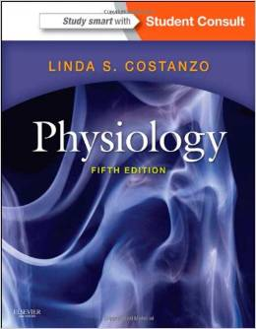
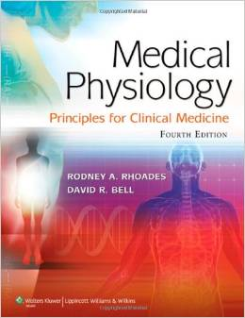
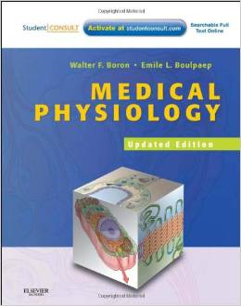
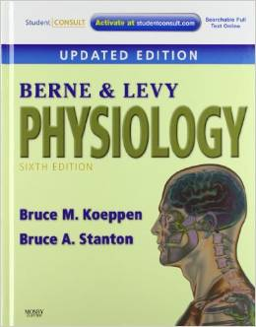
Reference book, didactic book, or review book?
Reference physiology books
Medical Physiology (Boron & Boulpaep)
Physiology (Berne and Levy)
Didactic physiology book
Physiology (Costanzo)
Medical Physiology (Rhoades)

Slide 8
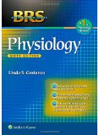
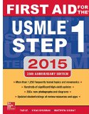
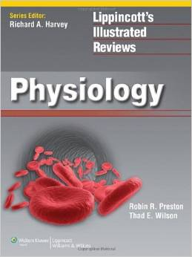
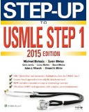
Reference book, didactic book, or review book? (cont’d)
Review books
BRS Physiology (Costanzo)
LIR Physiology
First Aid for USMLE Step 1
Step-Up to USMLE Step 1

Slide 9
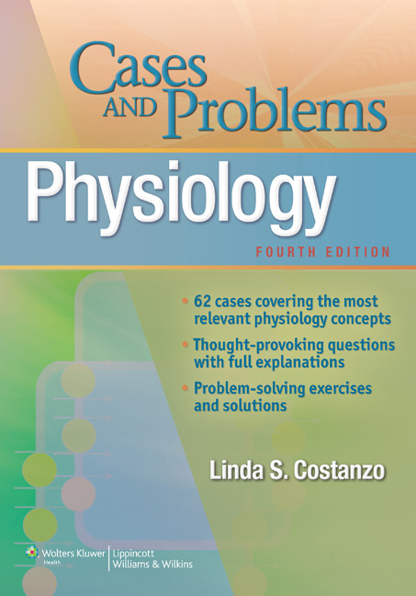
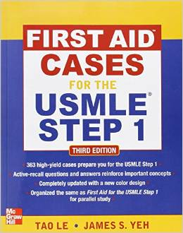
Case Books
Physiology Cases and Problems (Costanzo)
First Aid Cases for the USMLE Step 1

Slide 10
To write or not to write? That is your dilemma

Slide 11
What NOT to write (when studying physiology)
Do NOT “copy the notes”
Habit from undergrad days (fear of letting go of strategy that seemed to work)
Passive, Mindless
Eats up time (that could be used for learning, understanding, repetition, and doing practice questions)
Kick the habit now
But I need to write in order to learn!

Slide 12
What can I write that is useful and active?
Yes! Make your writing evolve → active
Don’t write until you know something about the topic
Depends on topic (for this topic, what would be most useful?)
Create a visual (list, comparisons, charts, sequence of events)
Synthesis
E.g., sheet with all major points about fetal lung
E.g., sheet with all major points about adrenal cortical hormones
Drill
Write a sequence from memory
Practice redrawing graphs
Write equations from memory
Practice problems

Slide 13
Practice Questions! The antidote to that “graph, equation, calculation” issue
Lots--Early and Often
Questions are learning tools (don’t wait until you’re “ready”)
Learn from the right and wrong answers
Test understanding, build confidence, practice test-taking strategies
Sources:
Self-assessments in your course
BRS Physiology (end-of-chapter)
Pre-test Physiology

Slide 14
Good test-taking in physiology
Read the stem carefully and underline critical words.
#1 test-taking problem in physiology is not answering the question asked.
Clearly identify the topic of the question and find that topic in your brain.
Cover the answers while working the question.
Work slowly enough to think through steps correctly.
Write main thinking steps in the margin.
Protects against changing “increases” to “decreases” in your mind.
Match your thinking with the answer choices and select the best answer.

Slide 15
Good test-taking, cont’d
First shot, best shot
Once slowly >> twice fast
Don’t be distracted by distractors
Don’t overthink
Directions say “single best answer” – stop there!
Don’t change answers impulsively.
If you’re going to change, work the question again from scratch.
Sleep (the night before).

Slide 16
Thank you for joining AMSA, Lippincott, & Dr. Costanzo this evening!
Dr. Costanzo’s email address:
lcostanz@vcu.edu
Webinar sponsored by LEARN
(The Lippincott/AMSA reviewer network)

